Slide 1
Greek food customs
Popular Greek customs that are related to food

Slide 2
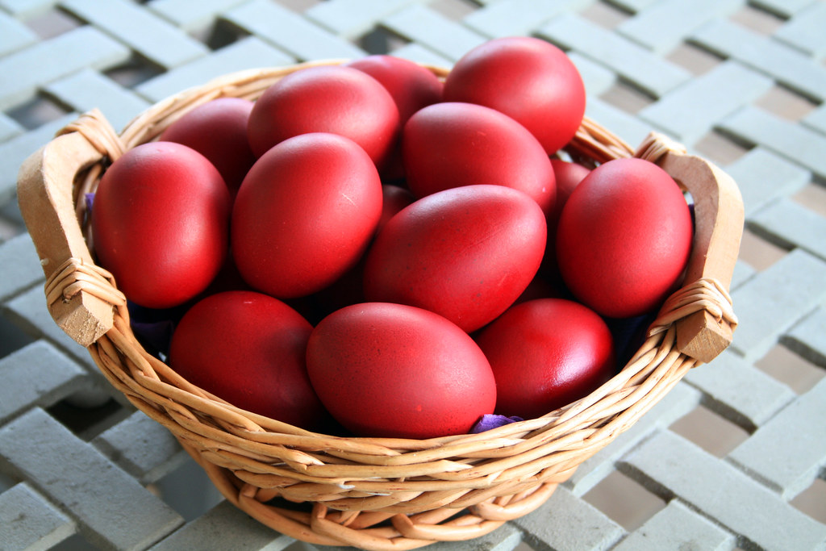
Easter red eggs
Traditionally, families across Greece dye eggs red on Holy Thursday. Dying eggs red in anticipation of Greek Easter is one of the oldest and most beloved traditions in Greece. Along with candles, church services, lamb, and the sweet bread tsoureki, eggs that have been tinted with red dye are one of the most iconic symbols of Easter in Greece. The red eggs hold significant religious symbolism, as the color red symbolizes the blood Christ shed on the cross. Additionally, the egg in itself is a symbol: its hard shell represents the sealed tomb of Jesus, the cracking of which symbolizes His resurrection from the dead and exit from the tomb.

Slide 3
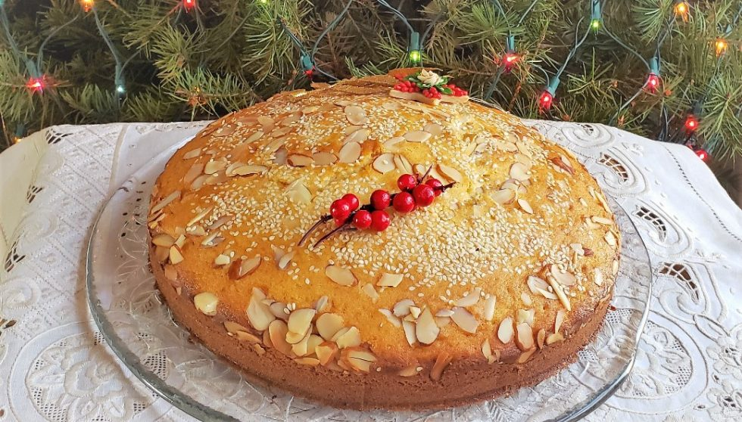
Vasilopita (St. Basil’s Pie)
Vasilopita is a New Year's Day bread, cake or pie in Greece and many other areas in eastern Europe and the Balkans which contains a hidden coin or trinket which gives good luck to the receiver, like the Western European King Cake. In most parts of Greece, it is associated with Saint Basil’s Day on January 1, whereas in some regions, the traditions surrounding a cake or pie with a hidden coin are attached to Epiphany (January 6) or to Christmas (December 25). It is made of a variety of dough, depending on regional and family tradition - in some families, instead of dough, it is made from a custard base called galatopita (literally milk pie). In the Thessaly region, a pork-filled pie with a hidden coin is made.

Slide 4
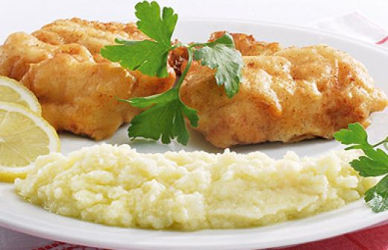
Batter-fried salt cod with skordalia
Batter-fried salt cod with skordalia is the traditional dish of the Greek national holiday of March 25. The fact that dried and salted cod is relatively cheap and can be preserved for a long time, made it an ideal choice for poor farmers of the past who did not own refrigerators. Skordalia is a thick purée in Greek cuisine made of garlic in a base of potatoes, walnuts, almonds or liquid-soaked stale bread mixed with olive oil to make a smooth emulsion, to which some vinegar is added. It is served as a sauce, side dish, or dip.

Slide 5
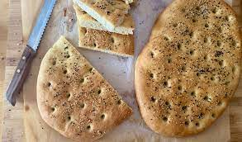
Lagana
Lagana is a Greek flatbread traditionally baked for Clean Monday, the first day of the Great Lent. Traditionally, it was prepared unleavened (without the yeast), but leavened lagana is nowadays more common. It is typically flat, oval-shaped, with surface decorated by impressing fingertips. Sesame seeds are a common topping, and it may also be topped with other herbs, and seasoned with olive oil.

Slide 6
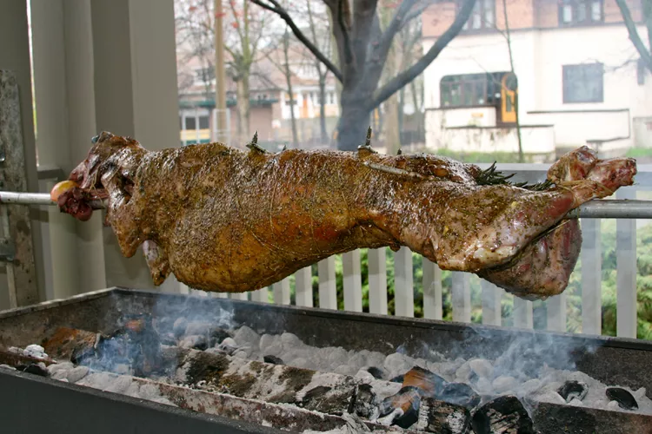
Lamb on the spit
On Easter Sunday, a lot of people grill lambs on the spit along with families, relatives and friends. The custom is of Jewish origin but the cooking method comes from the period when Greece was occupied by the Ottomans. At the time, shepherds used to live away from their homes for weeks or even months, so they were not able to roast their lambs in ovens. The only possible way to grill the meat was by making a handmade spit: they sharpened a branch until it was pointed and then they placed it on two crotches. Nowadays, modern spits are stainless and often rotate the lamb by using an electric motor.

Slide 7
And remember ...
No matter how delicious a meal at our favorite fast-food restaurant is, we should always try our local and national recipes. They can add variety to our diet and improve our well-being!

